Slide 1
LENDING CLUB CASE STUDY USING EDA
By
DEBABRATA GHOSH

Slide 2
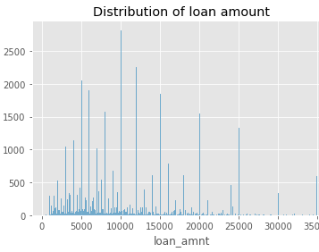
Distribution of loan amount
Points to be taken into consideration
Maximum loan amount is between 5000 to 10,000

Slide 3
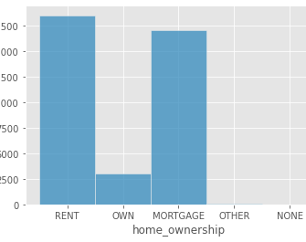
House Ownership
Most of the applicants live in a rented house
2nd most applicants home are in mortgage

Slide 4
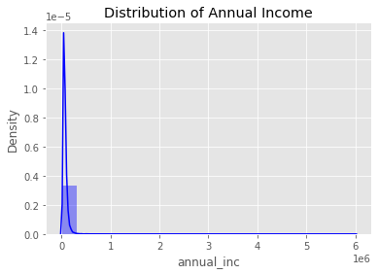
Annual Income Distribution
Annual income distribution is high

Slide 5
Biveriate Analysis

Slide 6
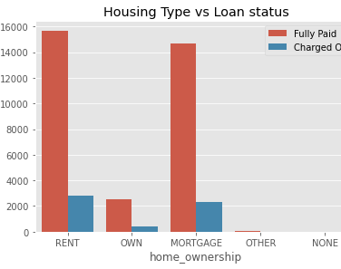
Home Ownership in comparison to repay the loan amount
Most of the applicants living in rent are the highest non-defaulters.
The applicants living in rent are the highest repayor's of the loan amount
Applicants living in home with mortgage are the 2nd highest re

Slide 7
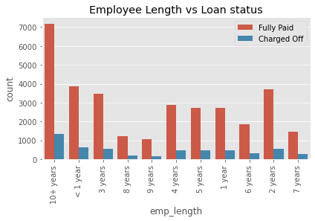
Employee Length with comparison for loan repay
Employees with greater than equal to 10 years of experience are the highest repayors of loan amount
Employees with same experience are the highest defaulters also

Slide 8
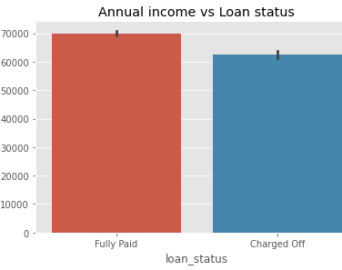
Annual income in comparison to loan repayment
The highest the annual income , the loan repayment is also high

Slide 9
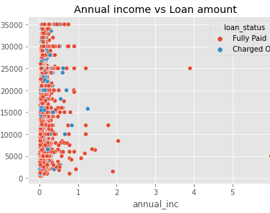
Annual income in comparison to loan amount
Those who have high annual income, the loan amount approval is also high for them

Slide 10
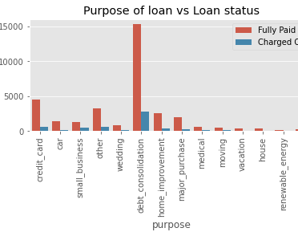
Purpose of loan in comparison to loan repayment
Debt consolidation has the highest number of loan repayment
Credit card holders are the 2nd highest non-defaulters

Slide 11
Recommendations
Applicants with high income should be granted full loan approval as they will be non-defaulters
Verify the applicants income, after which only the loan can be approved, so that they doesn’t become defaulters
Verify the applicants purpose of taking loan

Slide 12
Thank You

